Slide 1

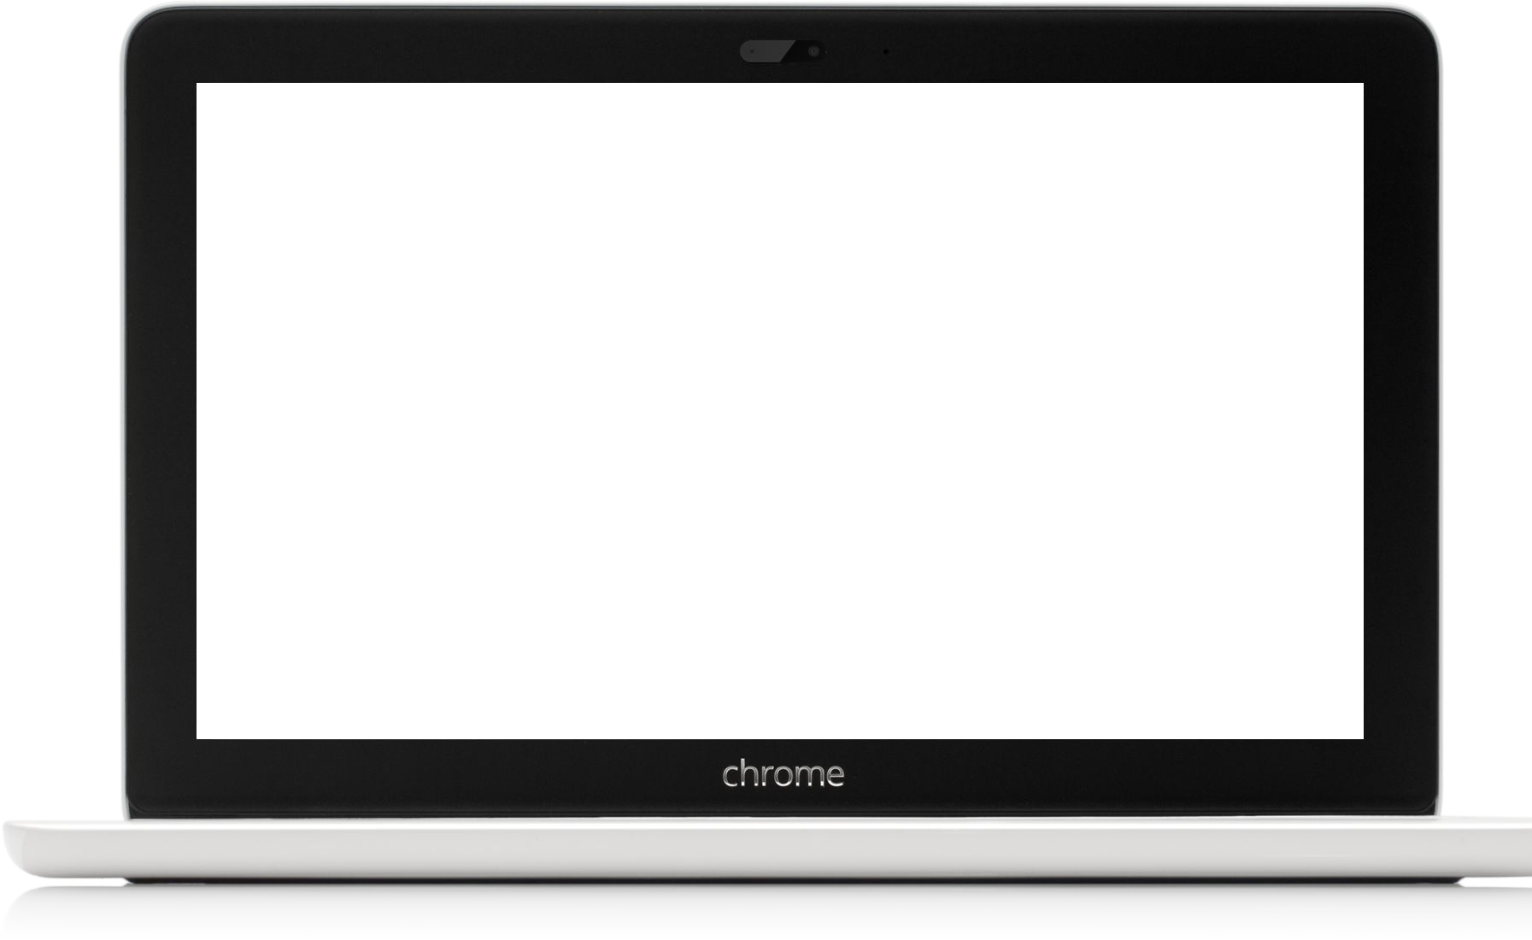
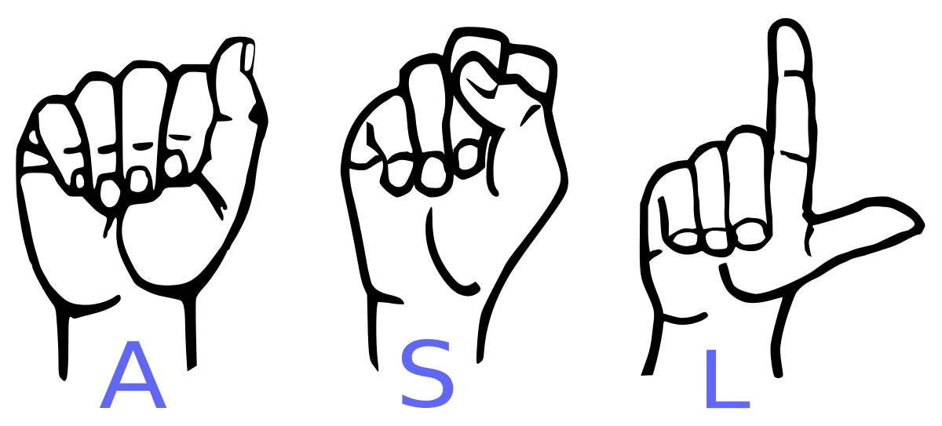
Sign Language to Text Conversion
Major Project

Slide 2
Introduction
Topic: Sign Language to Text Conversion
Team Members: Lalit Singh Dhami & Manish Bisht
Aim: To develop a real-time system that recognizes American Sign Language (ASL) gestures and converts them into text for communication.

Slide 3
Problem Statement
Communication Gap
Ineffective Solutions
Reliability and Accessibility
Dependence on Intermediaries

Slide 4
Project Overview
The project's primary goal is to enable real-time recognition of American Sign Language (ASL) gestures.
we will achieve this by utilizing a Convolutional Neural Network (CNN) to identify and interpret ASL hand gestures, and subsequently, it converts them into corresponding text.
Programming Language : Python
Deep Learning Framework: TensorFlow
OpenCV (Open Source Computer Vision Library)
Machine Learning Tools: Scikit-learn, Keras
Data Handling: NumPy (for numerical operations)
Model Deployment: PyInstaller for standalone application
Image Preprocessing: Gaussian blur, adaptive thresholding, grayscale conversion

Slide 5
Sign Language and Importance
Sign language is a visual and gestural language used by Deaf and Mute individuals as a primary means of communication.
It relies on handshapes, gestures, facial expressions, and body movements to convey information and express thoughts.
Sign language is the lifeline for Deaf and Mute individuals,
It provides a means for them to express themselves, engage with their communities, and access information and education.
Sign language is a vital part of Deaf culture and identity.
Sign language recognition tools is crucial to bridge the communication gap between Deaf and Mute individuals and the rest of the world.
Effective sign language recognition can improve accessibility and inclusivity in education, employment, and everyday interactions.

Slide 6
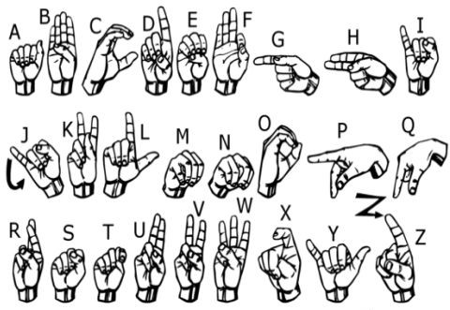
We implemented 27 symbols(A-Z, blank) of ASL in our project.

Slide 7
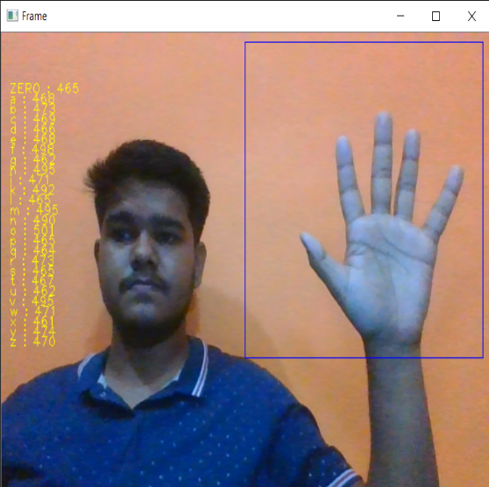
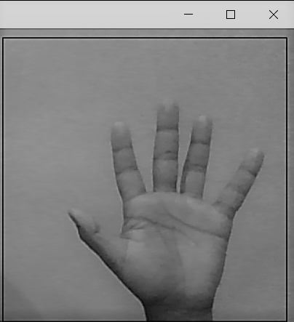
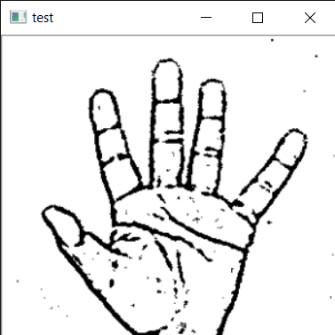

How we generated data set and did Data Preprocessing ?
Capturing Raw Image
Gray Scale Image
Image Post Gaussian Blur

Slide 8
Why we Created our own Dataset ?
➔ For the project we tried to find already made datasets but we couldn’t find dataset in the form of raw images that matched our requirements.
➔ All we could find were the datasets in the form of RGB values.
➔ Hence we decided to create our own data set.

Slide 9
Gesture Classification
Layer 1
Layer 2
Classify between 27 Symbols
Classify between Similar Symbols

Slide 10
Algorithm Layer 1
Apply gaussian blur filter and threshold to the frame taken with opencv to get the processed image after feature extraction.
This processed image is passed to the CNN model for prediction and if a letter is detected for more than 50 frames then the letter is printed and taken into consideration for forming the word.
Space between the words are considered using the blank symbol.

Slide 11
Algorithm Layer 2
We detect various sets of symbols which show similar results on getting detected.
We then classify between those sets using classifiers made for those sets only.
In our testing we found that following symbols were not showing properly and were giving other symbols also :
For D
For U
For I
For S
: R and U
: D and R
: T, D, K and I
: M and N

Slide 12
Challenges Faced
We couldn’t find a dataset with raw images of all the asl characters so we made our own dataset.
Second issue was to select a filter for feature extraction. We tried various filter including binary threshold, canny edge detection, gaussian blur etc. ,of which gaussian blur filter was giving better results.
Issues were faced relating to the accuracy of the model we trained in earlier phases which we eventually improved by increasing the input image size and also by improving the dataset.

Slide 13
What Next ?
We Will focus on increasing it’s accuracy.
we will try to make UI in python.

Slide 14
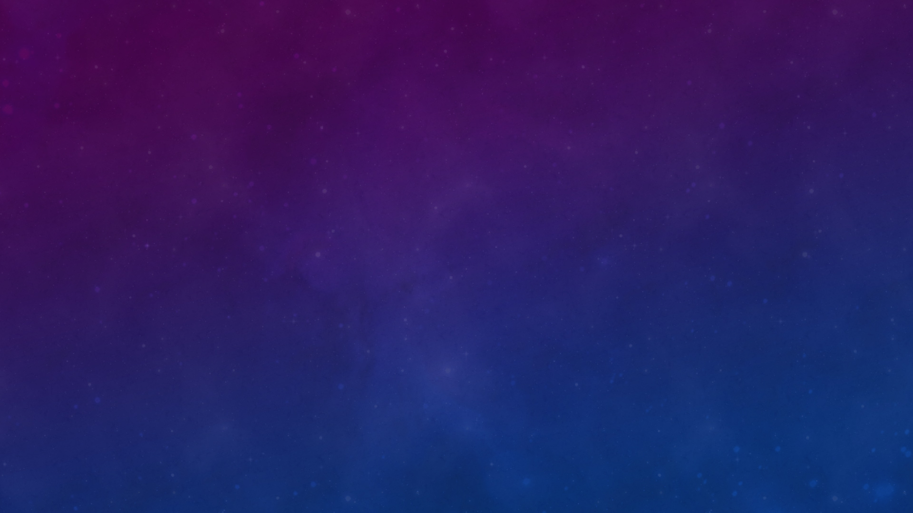

THANK YOU

